Slide 1
Composition

Slide 2
Inheritance and Composition
The two common ways to relate two classes in a meaningful way are:
Inheritance (“is-a” relationship)
Composition (“has-a” relationship)

Slide 3
Composition (objects inside the objects)

Slide 4
Composition
In composition, one or more member(s) of a class are objects of another class type
Composition is a “has-a” relation
Arguments to the constructor of a member-object are specified in the heading part of the definition of the constructor

Slide 5
Objects inside objects (1)
class Element {
int value;
public:
int Get(void) { return value; }
void Put(int val) { value = val; }
};
class Collection {
Element el1, el2;
public:
int Get(int elno) { return elno == 1 ? el1.Get() : el2.Get(); }
int Put(int elno, int val) { if(elno == 1) el1.Put(val); else el2.Put(val); }
};
int main(void) {
Collection coll;
for(int i = 1; i <= 2; i++)
coll.Put(i, i + 1);
for(int i = 1; i <= 2; i++)
cout << "Element #" << i << " = " << coll.Get(i) << endl;
return 0;
}

Slide 6
Objects inside objects (1)
An object of any class may be the field of an object of any other class.
All rules concerning access to class components are honoured in this case too.
There’s a very simple class named Element.
It’s intended to store one int value.
The second class displayed in the example is also simple, but there’s an interesting thing about it: there are two fields of the Element class.
As you can see, we can manipulate them with no great difficulty. They behave just like any other class component.
It’ll be no surprise to you when we say that the code produces the following output:
Element #1 = 2
Element #2 = 3
There are three objects in our example program:
coll(visible at the main function level) and el1 together with el2 (visible at the coll object level).
We want to know the sequence in which all constructors work.

Slide 7
Objects inside objects (2)
Here goes the modified code
We’ve cleaned the main function of everything that isn’t really needed to track the constructors activity.
We’ve compiled and run the program. This is what we see on the screen:
Element constructed!
Element constructed!
Collection constructed!
The conclusion is: constructors from inner objects (objects stored inside other objects) are invoked before the outer object’s constructors start their work.
This rule should be applied repeatedly.

Slide 8
Objects inside objects (2)
class Element {
int value;
public:
Element(void) { cout << "Element constructed!" << endl; }
int Get(void) { return value; }
void Put(int val) { value = val; }
};
class Collection {
Element el1, el2;
public:
Collection(void) { cout << "Collection constructed!" << endl; }
int Get(int elno) { return elno == 1 ? el1.Get() : el2.Get(); }
int Put(int elno, int val) { if(elno == 1) el1.Put(val); else el2.Put(val); }
};
int main(void) {
Collection coll;
return 0;
}

Slide 9
Objects inside objects (3)
We’ve changed the form of the Element class’ constructor – before it was a parameter-less function, now it needs one parameter of type int.
The modification has invalidated the program – it can’t be compiled. Why?
The compiler will produce an error message saying something like this:
In constructor 'Collection::Collection()':
error: no matching function for call to 'Element::Element()'
The constructor invoked implicitly (sometimes called the default constructor) is the one which has no parameters.
We haven’t delivered such a constructor. We haven’t delivered the copying constructor, either.
The only available constructor is compatible neither with the default one, nor with the copying constructor, and this makes our program incorrect.
How can we deal with this? Is there a trick to tell the compiler that we want it to use the other constructor instead of the default one?
Yes, there is. The “C++” language offers us a special syntax for this and similar situations.

Slide 10
Objects inside objects (3)
class Element {
int value;
public:
Element(int val) { value = val; cout << "Element(" << val << ") constructed!" << endl; }
int Get(void) { return value; }
void Put(int val) { value = val; }
};
class Collection {
Element el1, el2;
public:
Collection(void) { cout << "Collection constructed!" << endl; }
int Get(int elno) { return elno == 1 ? el1.Get() : el2.Get(); }
int Put(int elno, int val) { if(elno == 1) el1.Put(val); else el2.Put(val); }
};
int main(void) {
Collection coll;
return 0;
}

Slide 11
Objects inside objects (4)
If we want a constructor other than the default one to be invoked during the creation of an object which is part of another object, we should use the syntax on the right →
Take a look at this: we can present it in the following schematic way:
Class(…) : inner_field_constr1(…), inner_field_constr2(…) { … }
This means that you have to list all the inner objects’ constructors that you wish to use instead of the default constructors.
This is expressed in the line saying:
Collection(void) : el2(2), el1(1) { … }

Slide 12
Objects inside objects (4)
The program may be compiled successfully and when run it produces the following output:
Element(1) constructed!
Element(2) constructed!
Collection constructed!
Note that the inner constructors have been invoked in the sequence reflecting the order of the declarationinside the Collections class (el1 first), not in the order in which the constructors were listed in the Class constructor header (el2 first).

Slide 13
Objects inside objects (4)
And by the way, there’s the following alternation for this case: when the constructor is divided between the declaration and the definition, the list of alternative constructors should be associated with the definition, not the declaration.
This means that the following snippet is correct:
class X {
public:
X(int x) { };
};
class Y {
X x;
public:
Y(int x);
};
Y::Y(int x) : x(1) { };

Slide 14
Objects inside objects (4)
class Element {
int value;
public:
Element(int val) {
value = val; cout << "Element(" << val << ") constructed!" << endl;
}
int Get(void) { return value; }
void Put(int val) { value = val; }
};
class Collection {
Element el1, el2;
public:
Collection(void) : el2(2), el1(1) { cout << "Collection constructed!" << endl; }
int Get(int elno) { return elno == 1 ? el1.Get() : el2.Get(); }
int Put(int elno, int val) { if(elno == 1) el1.Put(val); else el2.Put(val); }
};
int main(void) {
Collection coll;
return 0;
}

Slide 15
Composition (continued)
Member-objects of a class are constructed:
In the order they are declared
Not in the order they are listed in the constructor’s member initialization list
Before the enclosing class objects are constructed

Slide 16
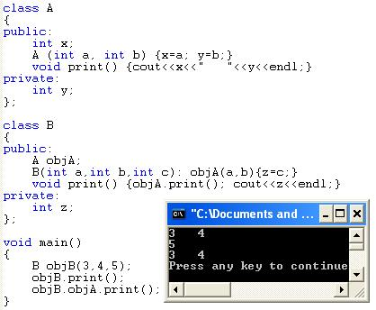
Example
objB
5
z
objA
3
x
4
y
Initialization list goes with the constructor contacting composition in order to pass parameters to the other class constructor.

Slide 17
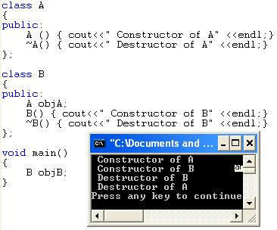
Composition (continued)
Member-objects of a class are constructed
In the order they are declared
Not in the order they are listed in the constructor’s member initialization list
Before the enclosing class objects are constructed

Slide 18
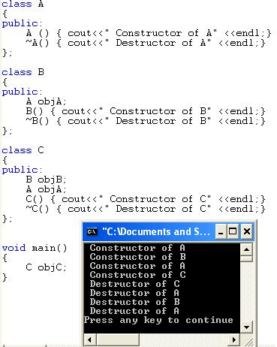
Example
objC
objB
objA
objA

Slide 19
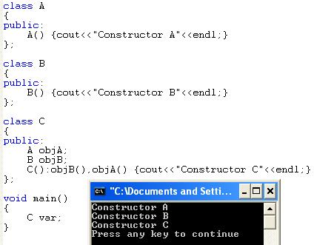
Example

Slide 20
student-course example

Slide 21
Composition
Student class needs to store the grades of students in a multiple courses.
So Grade class object should be a member of student class.
This is called composition, in which a class has objects of other types of members.
Data members are constructed in the same order in which they are declared in the class definition.
They are created before their enclosing class object(host) is created.
Notes:
Also called aggregation

Slide 22
class SGrades
{
string CourseName;
char Grade;
public:
SGrades() : Grade('B'), CourseName("OOP")
{
cout<<"Grade Constructor....."<<endl;
}

Slide 23
void SetValues(string CN, char G)
{
CourseName=CN;
Grade=G;
}
char GetGrades()
{
return Grade;
}
string GetCourseName()
{
return CourseName;
}

Slide 24
~SGrades()
{
cout<<"Grade Destructor ....."<<endl;
}
};

Slide 25
class Student
{
private:
int ID;
string Name;
SGrades C1;

Slide 26
public:
Student(int Id)
{
cout<<"Student Constructor....."<<endl;
Name="xyz";
ID=Id;
}
Student(int R, string n)
{
cout<<"Student Constructor....."<<endl;
Name=n;
ID=R;
}

Slide 27
void SetAttributes(int R, string n)
{
ID=R;
Name=n;
C1.SetValues("Web", 'A');
}
void GetAttributes()
{
cout<<"ID= "<<ID<<endl;
cout<<"Name= "<<Name<<endl;
cout<<"CourseName= "<<C1.GetCourseName()<<endl;
cout<<"Grades= "<<C1.GetGrades()<<endl;
}

Slide 28
~Student()
{
cout<<"Destructor Student....."<<endl;
}
};

Slide 29
#include<iostream>
#include"Student.h"
#include<string.h>
using namespace std;
int main()
{
Student S(0,"Abc");
S.SetAttributes(2, "Ali");
S.GetAttributes();
system("pause");
return 0;
}
Notes:
Employee example multiple structs

Slide 30
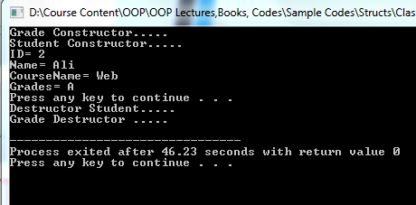

Slide 31
struct employeeType
{
string firstname;
string middlename;
string lastname;
string empID;
string address1;
string address2;
string city;
string state;
string zip;
int hiremonth;
int hireday;
int hireyear;
int quitmonth;
int quitday;
int quityear;
string phone;
string cellphone;
string fax;
string pager;
string email;
string deptID;
double salary;
};

Slide 32
struct nameType
{
string first;
string middle;
string last;
};
struct addressType
{
string address1;
string address2;
string city;
string state;
string zip;
};
struct dateType
{
int month;
int day;
int year;
};
struct contactType
{
string phone;
string cellphone;
string fax;
string pager;
string email;
};

Slide 33
struct employeeType
{
nameType name;
string empID;
addressType address;
dateType hireDate;
dateType quitDate;
contactType contact;
string deptID;
double salary;
};
employeeType newEmployee;

